Slide 1
Week 4
Inclusive education

Slide 2
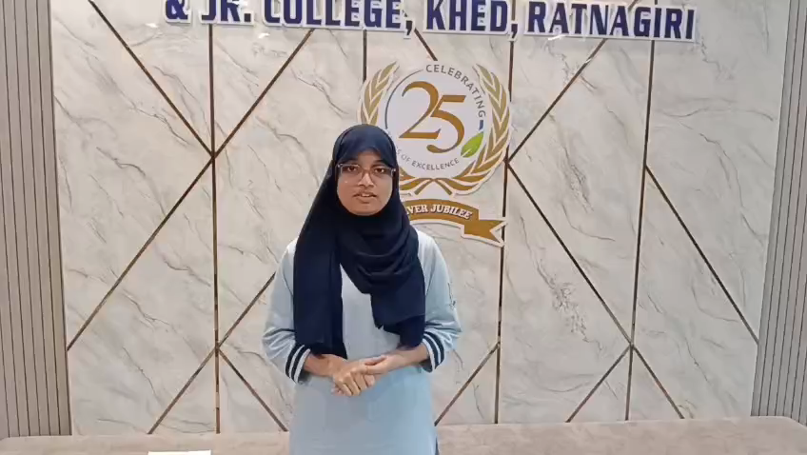

Slide 3
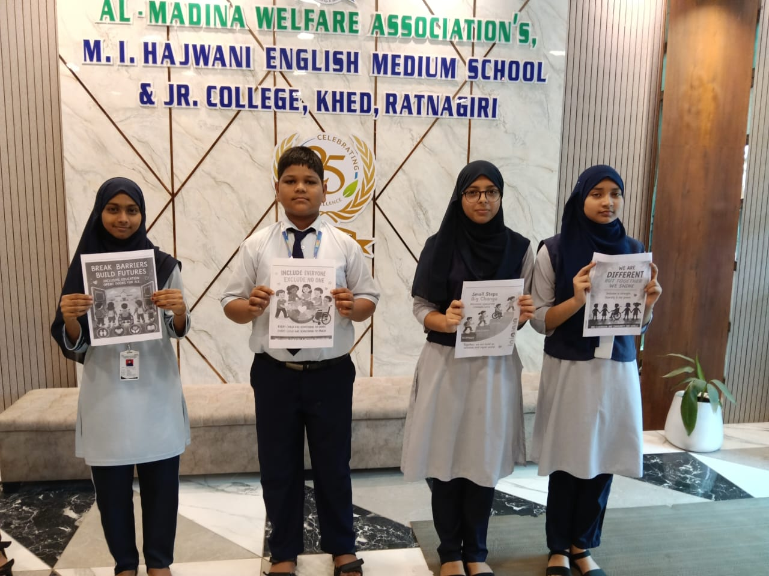

Slide 4
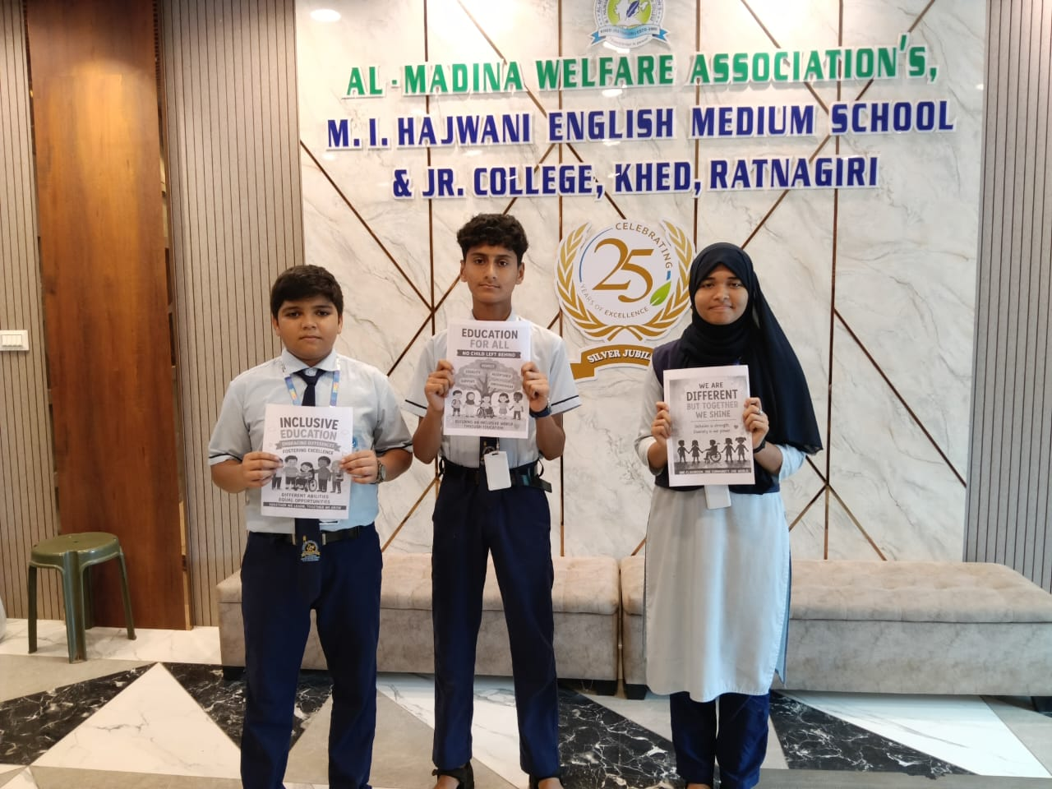

Slide 5
Inclusive Language Guidelines under SDG Project
Inclusive language means using words that respect and include everyone, regardless of gender, age, ability, culture, religion, or background.
Guidelines:
1)Use respectful and non-discriminatory words.
2)Avoid stereotypes based on gender, race, religion, disability, or culture.
3)Use gender-neutral terms where possible. Example: “ chairperson ” instead of “chairman”.
4)Use person-first and respectful language. Example: “ person with a disability” instead of “disabled person”.
5)Respect people’s names, identities, and preferred terms.
6)Avoid words that may exclude, insult, or stereotype others.
7)Promote equality, dignity, and belonging in communication.

Slide 6
THANK YOU

